Slide 1
Leadership Theories

Slide 2
“Trust men and they will be true to you; treat them greatly and they will show themselves to be great.”
    Ralph Waldo Emerson

Slide 3
Leadership Models
Model One: authoritarian, democratic or laissez-faire
Model Two: task vs interpersonal

Slide 4
Authoritarian
A style of leadership in which the leader uses strong, directive, controlling actions to enforce the rules, regulations, activities and relationships in the work environment.
        Organizational Behavior, Nelson & Quick

Slide 5
Authoritarian
Sets goals individually
Engages primarily in one-way, downward communication
Controls discussions of followers
Sets policy and procedures unilaterally
Dominates interaction
Personally directs the completion of tasks
Provides infrequent positive feedback
Rewards obedience and punishes mistakes
Exhibits poor listening skills
Uses conflict for personal gain

Slide 6
Democratic
A style of leadership in which the leaders takes collaborative, responsive, interactive actions with followers concerning the work and the work environment.
        Organizational Behavior, Nelson & Quick

Slide 7
Democratic
Involves followers in setting goals
Engages in two-way, open communication
Facilitates discussion with followers
Solicits input regarding determination of policy and procedures
Focuses interaction
Provides suggestions and alternatives for the completion of tasks
Provides frequent positive feedback
Rewards good work and uses punishment only as a last resort
Exhibits effective listening skills
Mediates conflict for group gain

Slide 8
Laissez-Faire
(“leave them alone”)
A style of leadership in which the leader fails to accept the responsibilities of the position.
        Organizational Behavior, Nelson & Quick

Slide 9
Laissez-Faire
Allows followers free rein to set their own goals
Engages in noncommittal, superficial communication
Avoids discussion with followers to set policy and procedures
Avoids interaction
Provides suggestions and alternatives for the completion of tasks only when asked to do so by followers
Provides infrequent feedback of any kind
Avoids offering rewards or punishments
May exhibit either poor or effective listening skills
Avoids conflict

Slide 10
Interpersonal Orientation
Solicits opinions
Recognizes the positions, ideas, and feelings of others
Engages in flexible, open communication
Listens carefully to others
Makes requests
Focuses on feelings, emotions, and attitudes as they relate to personal needs
Emphasizes productivity through the acquisition of personal skills
Most often communicates orally
Maintains an “open door” policy

Slide 11
Task Orientation
Disseminates information
Ignores the positions, ideas and feelings of others
Engages in rigid, stylized communication
Interrupts others
Makes demands
Focuses on facts, data and information as they relate to tasks
Emphasizes productivity through the acquisition of technical skills
Most of the time communicates in writing
Maintains a “closed door” policy

Slide 12
Studies that Identified Communication Patterns of Leaders
The Michigan Leadership Studies
The Ohio State Leadership Studies
McGregor’s Theory X and Theory Y
Blake and McCanse’s Leadership Grid

Slide 13
The Michigan Leadership Study
Conducted shortly after WWII
One dimensional
Identified two basic leadership styles:
  Production oriented
  Employee oriented
A building block for newer leadership studies

Slide 14
Ohio State Leadership Studies
After WWII
Measured specific leader behaviors
Identified two dimensions
  Consideration
  Initiating Structure
A leader could possess varying amounts of both dimensions

Slide 15
Theory X and Theory Y
Douglas McGregor, MIT Professor
Identified two approaches to supervision:
  Theory X: These managers think people do not like to work and like strict supervision.
  Theory Y: These managers think work is a source of satisfaction and want the responsibility.

Slide 16
Theory X
People don’t like to work and will avoid it.
People do not have ambition and want to be led or controlled.
The threat of punishment makes them work.
People do not want responsibility.
People are resistant to change.
People are gullible and not very smart.

Slide 17
Theory Y
The average person does not inherently dislike work.
People will exercise self-direction and self control in the performance of their jobs.
The average person learns under proper circumstances not only to accept to but to seek responsibility.
The proper leadership can bring out these qualities in workers.

Slide 18
Blake and McCanse’s Leadership Grid
Has also been called the Managerial Grid
Focuses communication styles
  1,1 Impoverished Mgt
  9,1 Authority-Compliance
  5,5 Middle of the Road Management
  1,9 Country Club Management
  9,9 Team Management

Slide 19
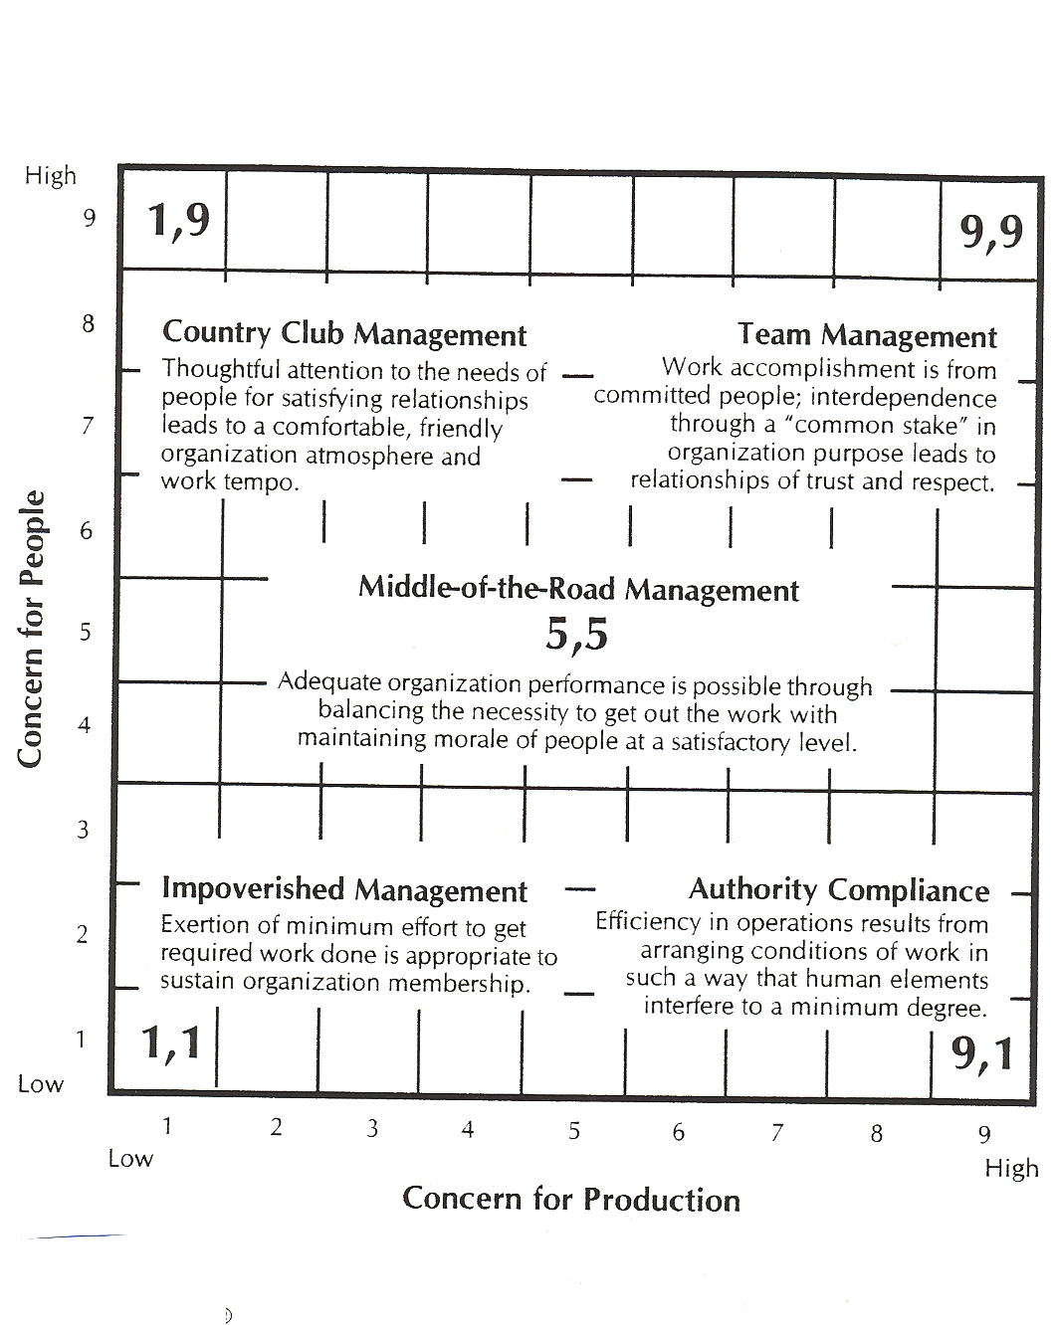

Slide 20
Traits Approach to Leadership
Born with leadership traits
Not sure what those characteristics were:
  Height
  Weight
  Appearance
  Intelligence
  Disposition
Inconsistent findings
Certain traits may enhance the perception that somebody is a leader

Slide 21
Trait Approach
Situational Approaches
  Fiedler’s Contingency Model of Leadership
  Path-Goal Theory
  Hersey and Blanchard’s Situational Leadership Theory
  Leader-Member Exchange Theory

Slide 22
Research
Interpersonal Factors
  Emotional stability
  Self confidence
  Manage conflict
Cognitive Factors
  Intelligence>problem solving and decision making
Administrative Factors
  Planning and organizational skills
  Knowledge of work being performed

Slide 23
Situational Approaches to Leadership Study
Fiedler’s Contingency Model of Leadership
Path-Goal Theory
Hersey and Blanchard’s Situational Leadership Theory
Leader-Member Exchange Theory

Slide 24
Fiedler’s Contingency Model
Least Preferred Co-Worker
Leader Situation has 3 dimensions:
  Position Power
  Task Structure
  Leader-Member Relations
Leader effectiveness in a given situation is affected by their LPC score.
Criticism of the theory

Slide 25
Path Goal Theory
Based on expectancy theory
Motivate followers through communication and situations. Communication styles are:
  Directive Leadership
  Supportive Leadership
  Participative Leadership
  Achievement-oriented Leadership
Situational Factors:
  Nature of Followers
  Nature of Tasks

Slide 26
Leader Roles in the Path-Goal Model
Path Clarification
  Leader defines what follower needs to do to gain outcomes
  Leader clarifies follower’s work roles
  Follower gains knowledge and confidence
  Follower is motivated and shows increased effort
  Organizational goals are achieved

Slide 27
Leader Roles in the Path-Goal Model
Increase rewards
  Leader finds out about follower’s needs
  Leader matches follower’s needs to rewards if work outcomes are accomplished
  Leader increases value of work outcomes for follower
  Follower is motivated and shows increased effort
  Organizational goals are achieved

Slide 28
Situational Leadership Theory
Hersey and Blanchard say the level of maturity of a worker plays a role in leadership behavior
Maturity consists of:
  Job maturity – talks-related abilities, skills and knowledge
  Psychological maturity – feelings of confidence, willingness and motivation
Follower readiness
Leader behavior

Slide 29
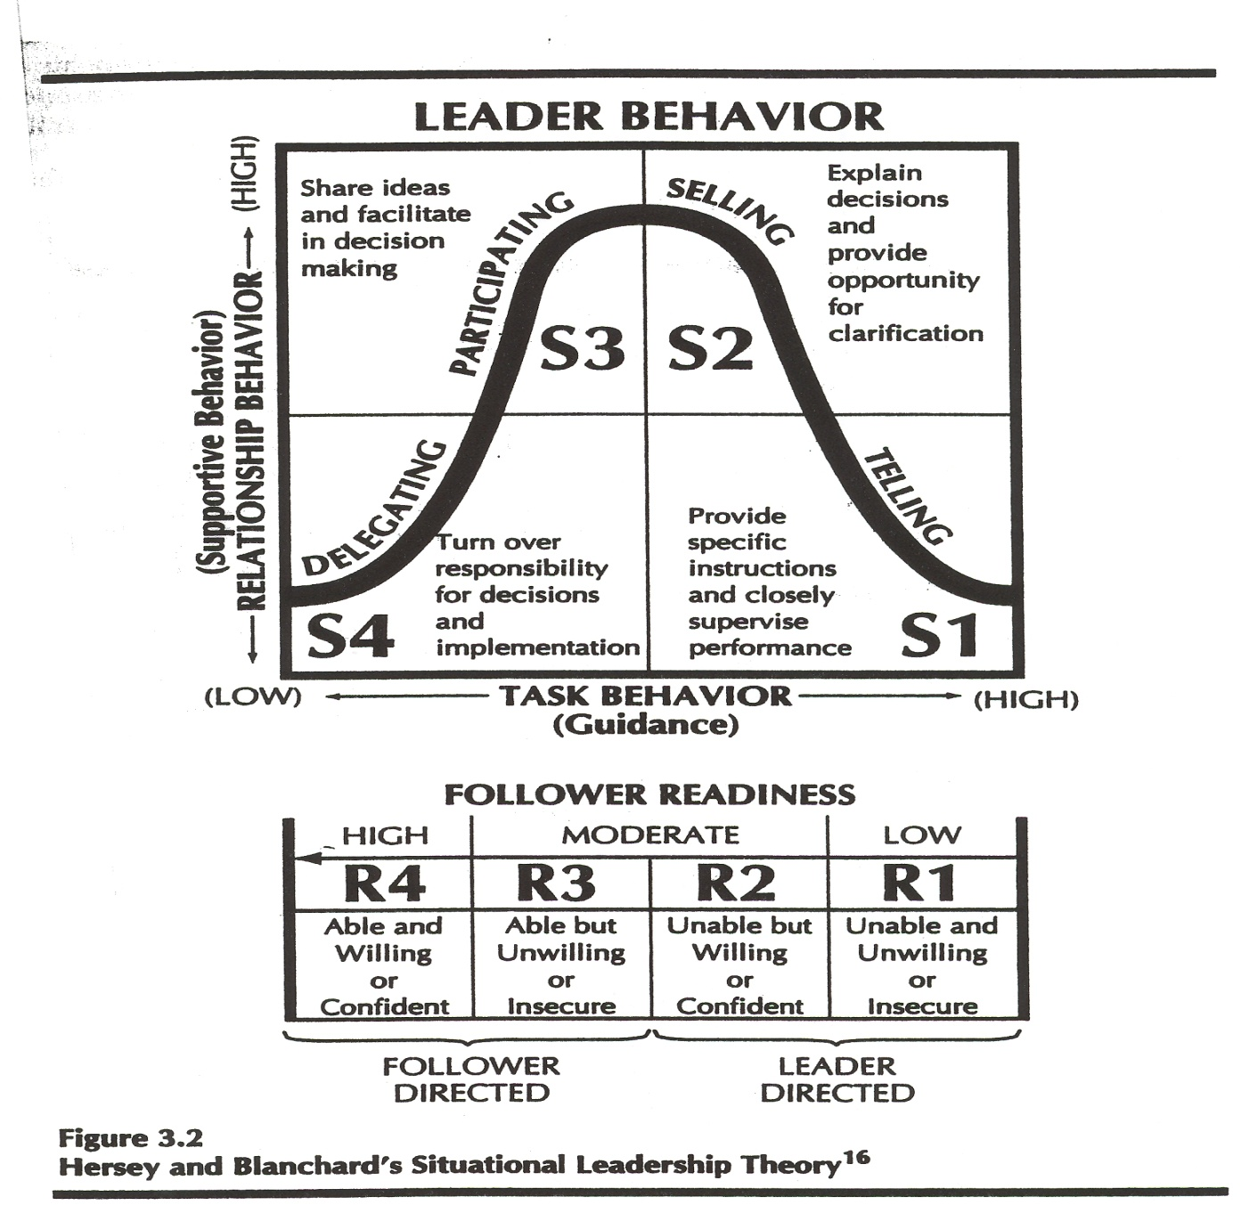
Situational Leadership Theory

Slide 30
Leader Member Exchange (LMX)
How leaders develop relationships with followers
  In group
  Out group
Satisfaction
Stress
Work load

Slide 31
Functional Approach to Leadership
Ability to communicate like a leader determines leadership
Theories
  Barnard
  Benne and Sheats

Slide 32
The Vroom-Jago Contingency Model
A contingency model that focuses on varying degrees of participative leadership, and how each level of participation influences quality and accountability of decisions.

Slide 33
Five Leader Decision Styles
Leader decides
Leader consults individuals
Leader consults the group
Leader acts as a facilitator for the group
Leader delegates decision to the group

Slide 34
Diagnostic Questions
Decision significance
  How significant is this decision for the project or organization?
Importance of commitment
  How important is subordinate commitment to carrying out the decision?
Leader expertise
  What is the level of the leader’s expertise in relation to the problem?
Likelihood of commitment
  If the leader were to make the decision alone, would subordinates have high or low commitment?

Slide 35
Diagnostic Questions
Group support for goals
  What is the degree of subordinate support for the team’s or organization’s objectives at stake in this decision?
Goal expertise
  What is the level of group members’ knowledge and expertise in relation to the problem?
Team Consequence
  How skilled and committed are group members to working together as a team to solve problems?

Slide 36
References
Debra L. Nelson and James Campbell Quick, Organizational Behavior (Ohio: Thomson, 2006) 148-177.
Michael Z. Hackman and Craig E. Johnson, Leadership (Illinois: Waveland Press, 2004) 35-87.
Richard L. Daft, The Leadership Experience (Ohio, Thomson, 2008) 45-71.

